Slide 1
VP160 Review Class 1
by Li Chunchao
2016/6/15

Slide 2
Short Review

Slide 3
Problems in Homework

Slide 4
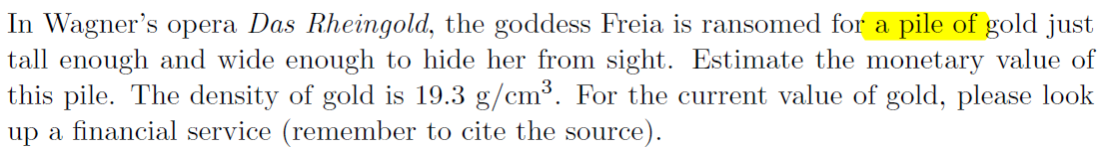

Read the Problems

Slide 5
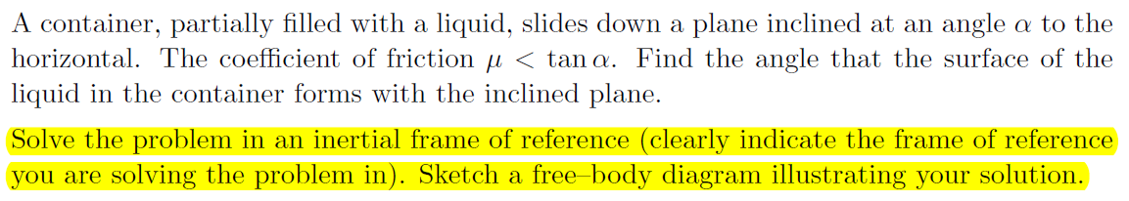
Read the Problems

Slide 6
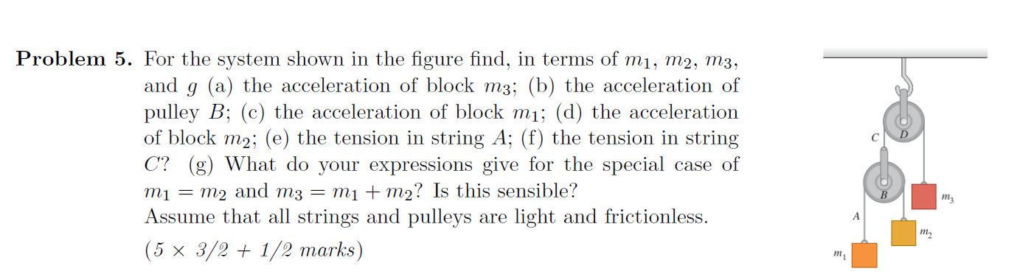
Don’t Trust Intuition

Slide 7
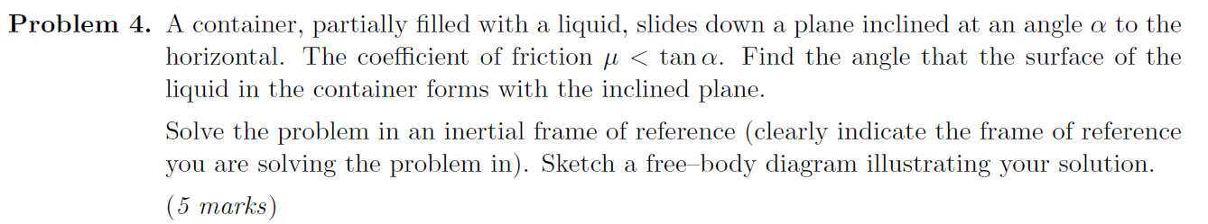
How to Find the Surface of liquid

Slide 8
Small Tricks to Check Answer

Slide 9
Unit
$$T=\frac{4m_{1}m_{2}g}{4m_{1}m_{2}+m_{2}m_{3}+m_{1}m_{3}}$$

Slide 10
Special Case
$$a_{1}=\frac{3m_{1}m_{2}+4m_{1}m_{3}+7m_{2}m_{3}}{4m_{1}m_{2}+m_{2}m_{3}+m_{1}m_{3}}g$$

Slide 11

Symmetry
$$a_{1}=\frac{4m_{1}m_{2}−6m_{1}m_{3}+8m_{2}m_{3}}{4m_{1}m_{2}+m_{2}m_{3}+m_{1}m_{3}}g$$
$$a_{2}=\frac{2m_{1}m_{2}−4m_{1}m_{3}+5m_{2}m_{3}}{4m_{1}m_{2}+m_{2}m_{3}+m_{1}m_{3}}g$$

Slide 12
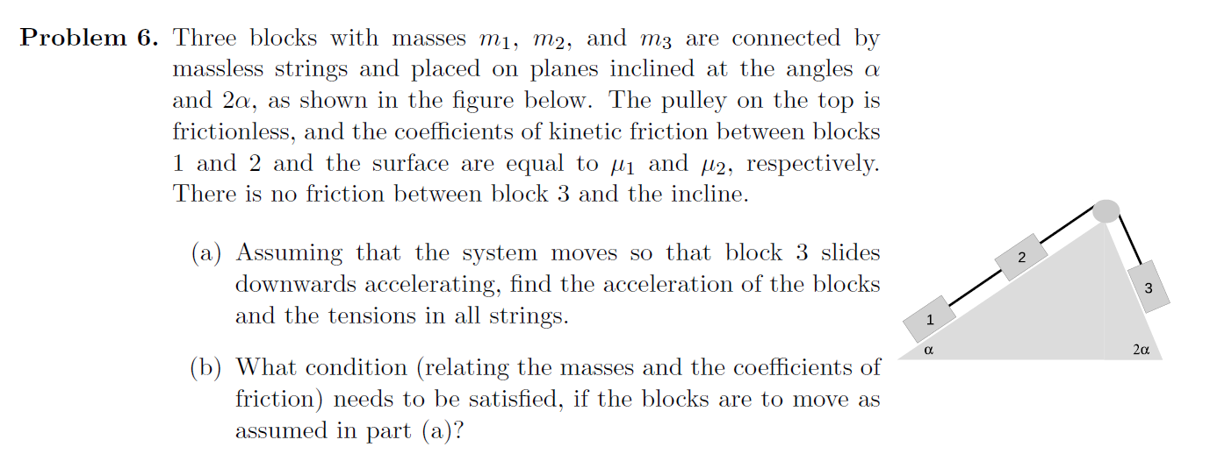

Analysis
$$T=\frac{ (m_{2}m_{3}μ+.. ….)}{m_{1}+m_{2}+m_{3}}g$$

Slide 13
Solving Problems

Slide 14
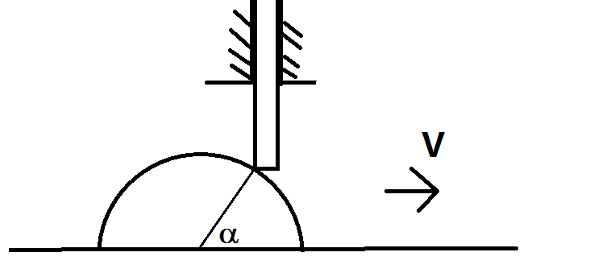
Kinematics
A stick can only move up and down, a semicylinder move below the stick with speed v, we know the angle α and radius R. Find the speed and the acceleration of the stick.

Slide 15
Q&A

